Slide 1

Building & Operating a Mini Security Operations Center (SOC)
Centralized Security Monitoring & Threat Detection System | Team 2 | DEPI (Information Security Analyst) 2026

Slide 2


Our Team
Mohamed Abdallah Ahmed
Dina Essam Fathy
Supervised by: Osama Abdelazim
Karim Nagi Hassan
Mohamed Ashraf Fathy
Zeyad Rafaat Kamal

Slide 3
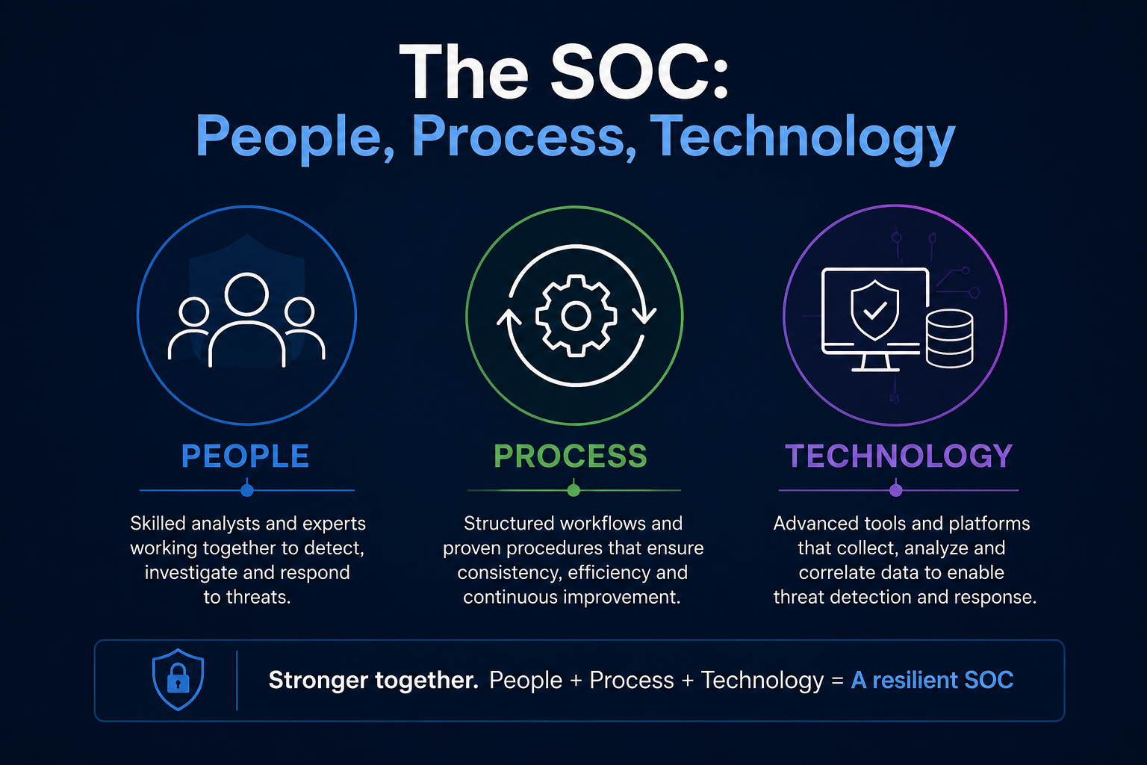



The SOC: People, Process, Technology
The Security Operations Center (SOC) is a centralized function responsible for continuously monitoring, detecting, and responding to security threats across the organization.
People: Security analysts who monitor, investigate, and respond to incidents.
Process: Structured workflows for triage, analysis, and incident response.
Technology: Tools like SIEM, EDR, and automation/orchestration platforms.

Slide 4
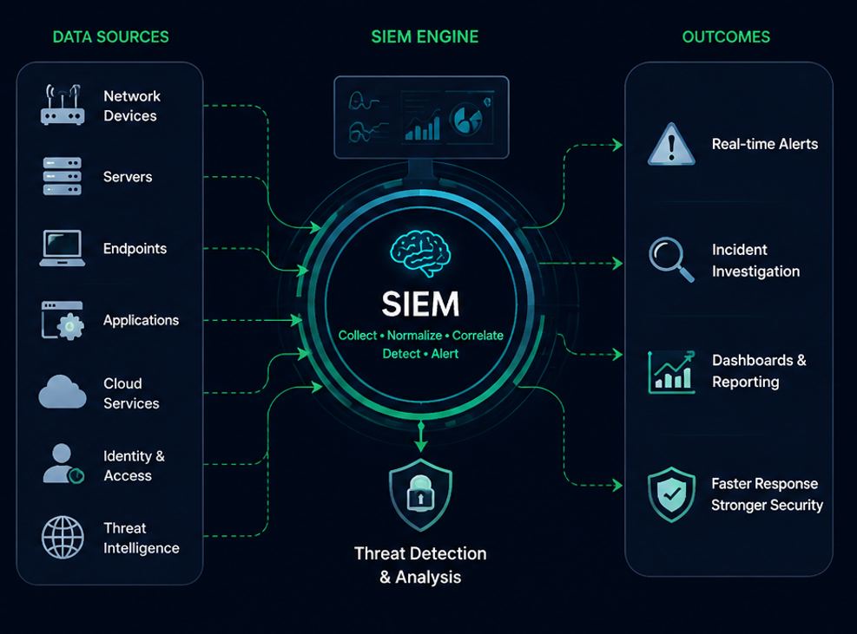



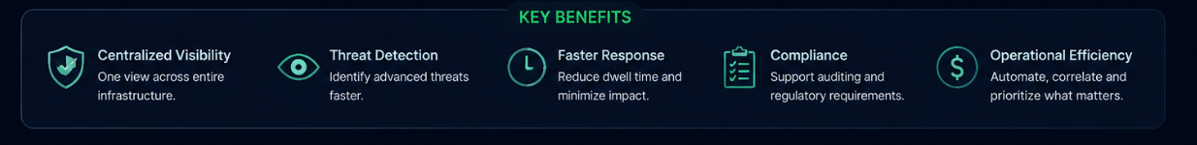

SIEM: The Brain of the SOC
SIEM (Security Information and Event Management) is a cybersecurity solution that collects, analyzes and correlates logs and security events from multiple systems in real time to detect threats, investigate incidents and support fast and effective response.
Collection: Gathering logs and events from all assets and systems across the environment.
Normalization: Standardizing and organizing data into a common format (ECS format).
Correlation: Connecting dots between to identify patterns and suspicious activity.
Alerting: Notifying analysts of potential threats for investigation and response.

Slide 5







Presentation Agenda
Project Intro
Architecture
Use Cases
Analysis
Overview, Problem Statement and Core Objectives.
Network Topology, VM Inventory and Monitoring Stack.
Brute Force, PowerShell, USB Attack transfer and windows reconnaissance commands attack.
Risk Assessment, KPIs and Final Recommendations.

Slide 6


Project Overview & Objectives
01 Problem Statement
02 Primary Objectives
Traditional Security architectures suffer from fragmented visibility and siloed logging. Without centralized correlation, detecting sophisticated lateral movement or credential access becomes a manual, slow and error-prone process.
To establish a proactive defense posture by automating threat detection. Our goal is to map simulated attacks to the MITRE ATT&CK framework, reduce dwell time through real-time alerting, and streamline the incident investigation workflow.
03 Project Overview
This project implements a containerized Mini-SOC infrastructure using the Elastic Stack (ELK). The environment integrates a Windows target machine with Elastic Agents to stream Security, System, and PowerShell logs through a dedicated pipeline for centralized indexing and analysis.

Slide 7
Project Timeline & Milestones
Week 1
Week 2
Week 3
Week 4
Environment Setup: Docker deployment of Elastic Stack and Fleet Server configuration.
Log Ingestion: Windows Agent installation and log pipeline verification.
Simulations: Executing Brute Force and PowerShell attacks; tuning detection rules.
Finalization: Dashboard creation, reporting, and SOC workflow validation.

Slide 8
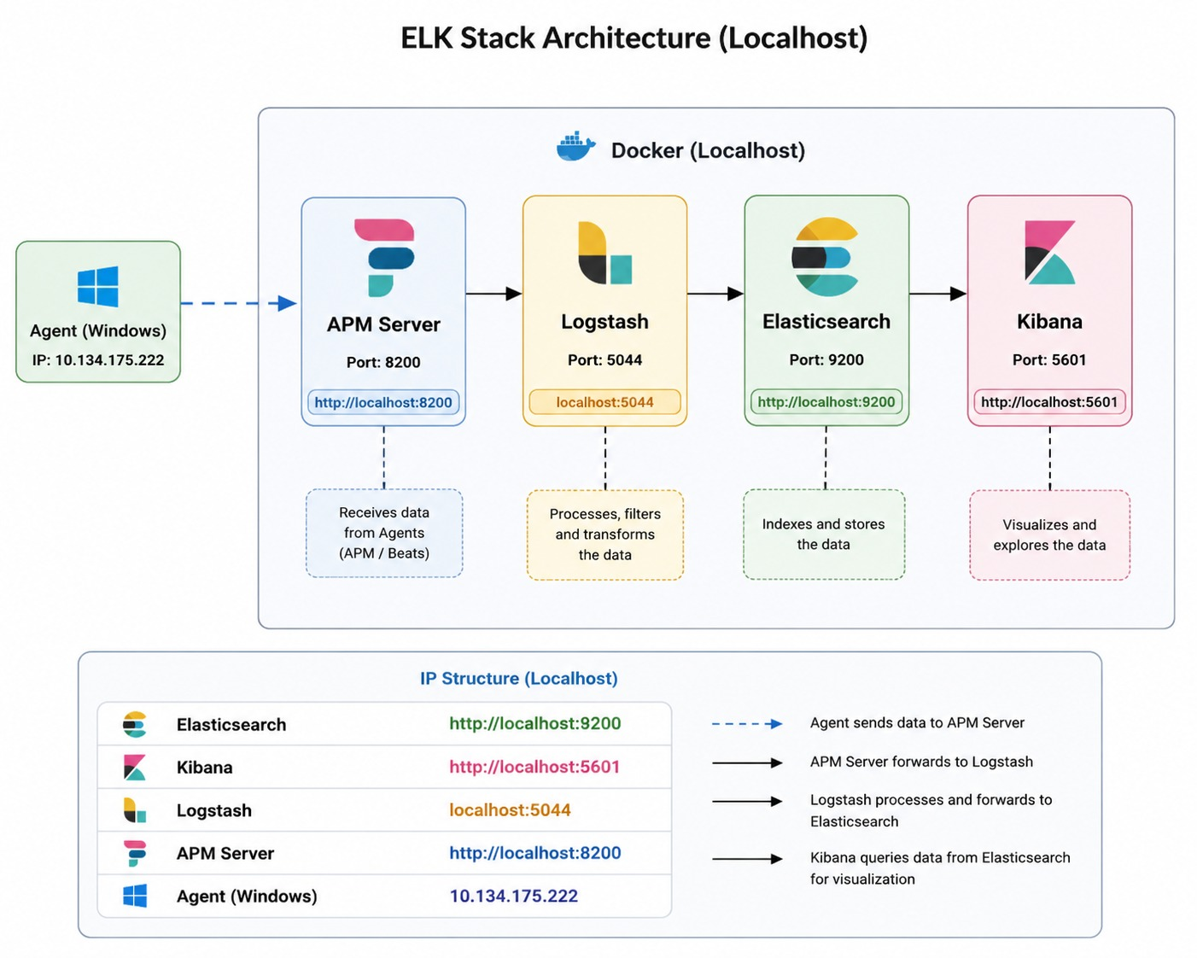
VM Inventory & Infrastructure

Slide 9
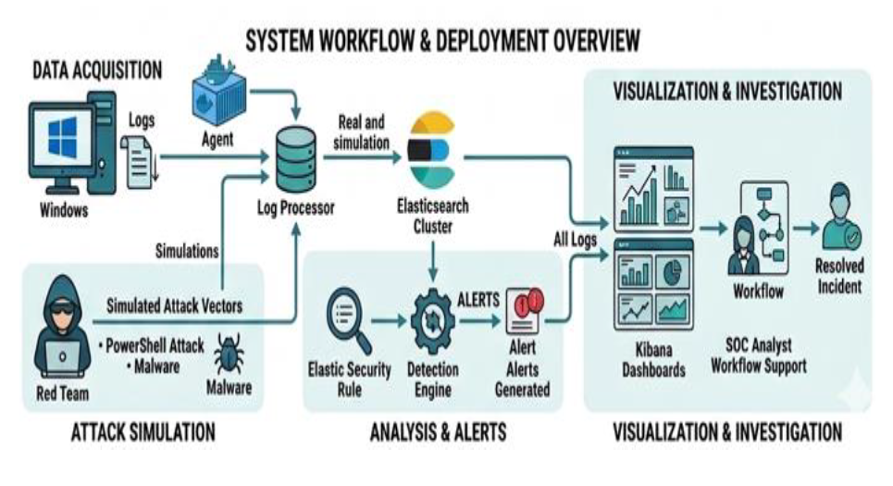



Lab Architecture & Data Flow
Data Acquisition: Elastic Agent captures Windows Security, System, and PowerShell logs.
Log Processing: Fleet Server coordinates agents while Logstash filters data into ECS format.
Data Storage: Normalized logs are indexed instantly in Elasticsearch for fast retrieval.
Detection Engine: Elastic Security analyzes events against real-world MITRE ATT&CK rules.
Alert Visualization: SOC Analysts hunt threats and investigate event timelines in Kibana.

Slide 10







The Detection & Monitoring Stack
Elastic Agent
Fleet Server
Elastic Search
Endpoint log collection: Security, System, and PowerShell event logs.
Centralized agent management and security policy deployment.
Data storage, indexing and fast log search engine.
Kibana
Elastic Security
Visualization, dashboards and analyst visual interface.
Detection Engine running rules mapped to MITRE ATT&CK framework.

Slide 11
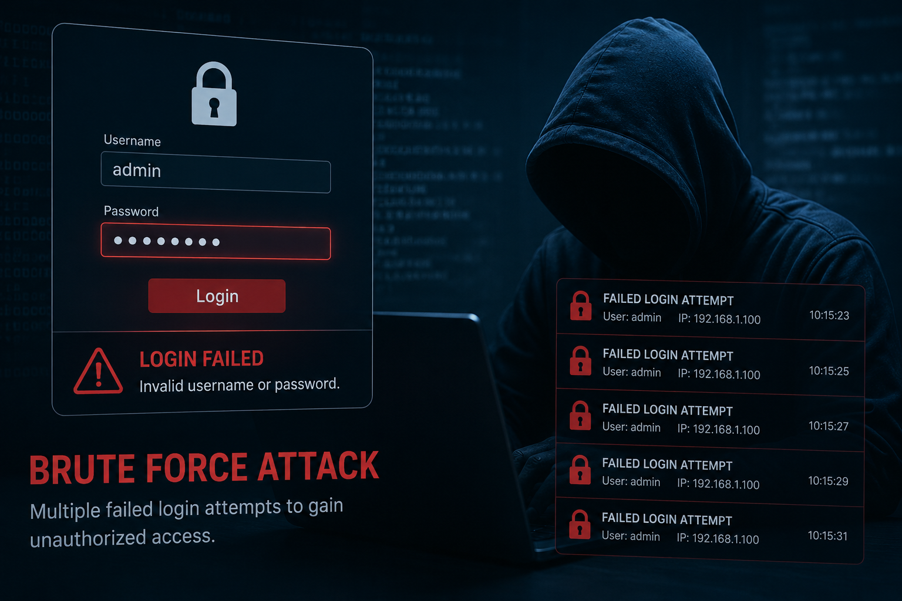
Use Case 1: Brute Force
Description: Multiple failed authentication attempts from a single source IP.
MITRE: T1110 - Brute Force.
Detection: Windows Event Code 4625 (Login Failure).
Alert: Triggered when count ≥ 10 failed logins within 5 minutes.

Slide 12
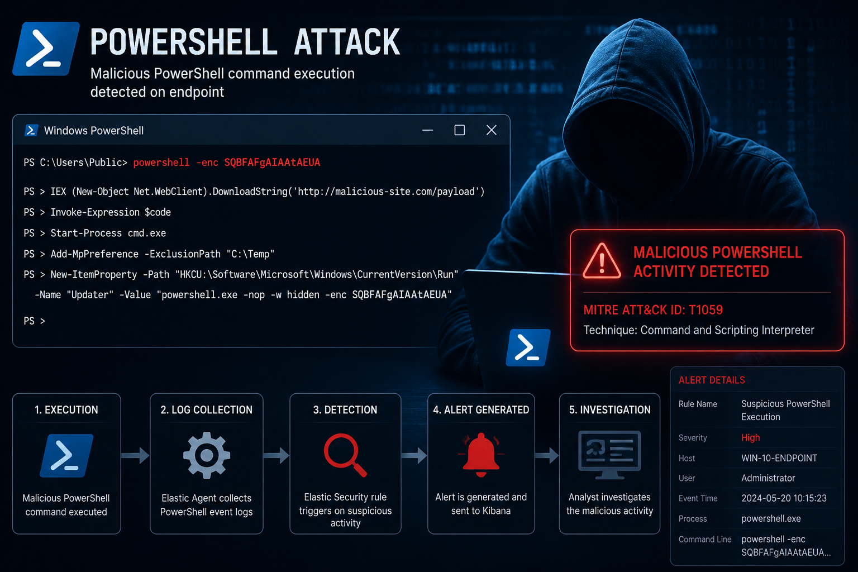
Use Case 2: PowerShell Attack
Detection of malicious script execution using PowerShell commands, including encoded commands and hidden windows.
MITRE: T1059 - Command & Scripting Interpreter.
Detection: Script block logging and command-line monitoring.
Alert: High severity alert generated for -EncodedCommand usage.

Slide 13
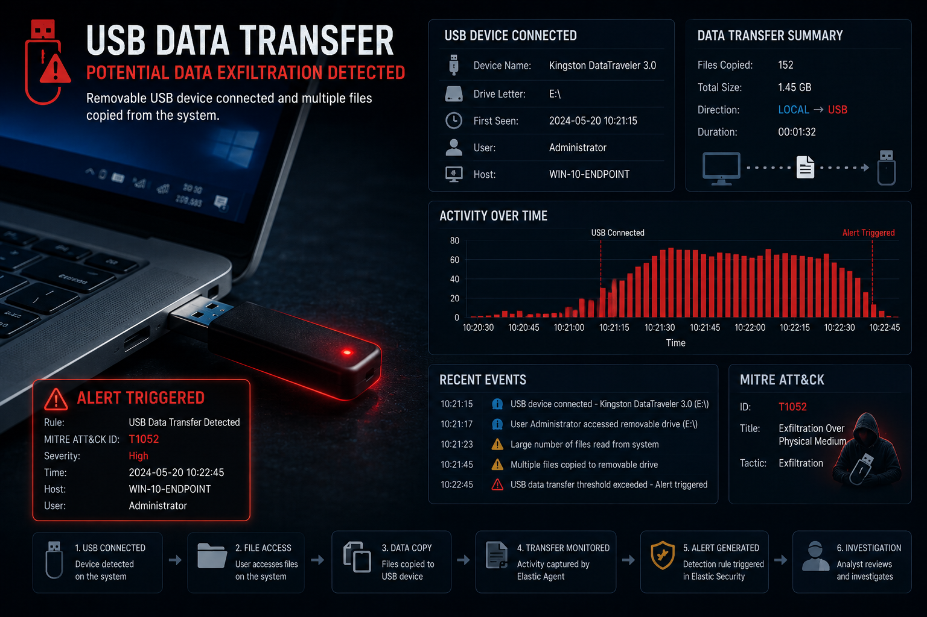
Use Case 3: USB Data Transfer
Monitoring unauthorized data transfer via removable storage devices to prevent data exfiltration.
MITRE: T1052 - Exfiltration Over Physical Medium.
Detection: Monitoring USB insertion events and file copy operations.
Response: Policy-based restriction and logging of device serial numbers.

Slide 14
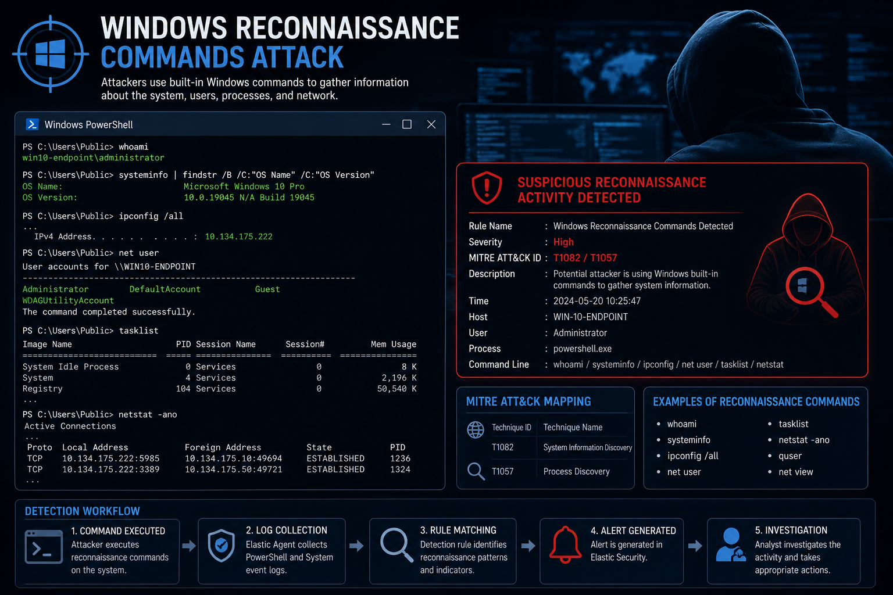
Use Case 4: Windows Reconnaissance Commands Attack
Description: Tracking internal discovery commands used by attackers to map system configurations and identify weaknesses.
MITRE: T1082 - System Information Discovery | T1057 - Process Discovery.
Detection: Monitoring PowerShell/CMD execution logs and real-time process monitoring events through Elastic Agent.
Response: Restricting user privileges, enabling command-line auditing, and isolating affected host nodes for investigation.

Slide 15
Risk Assessment & Performance KPIs
< 2 min
Efficiency Metrics
By using the Elastic Stack, we achieved significant improvements in threat visibility and response speed.
Mean Time to Detect (MTTD)
100% Log Coverage: All critical Windows events ingested.
0 False Negatives: All simulated attacks successfully alerted.
99% Uptime: High availability of the Dockerized SIEM.

Slide 16
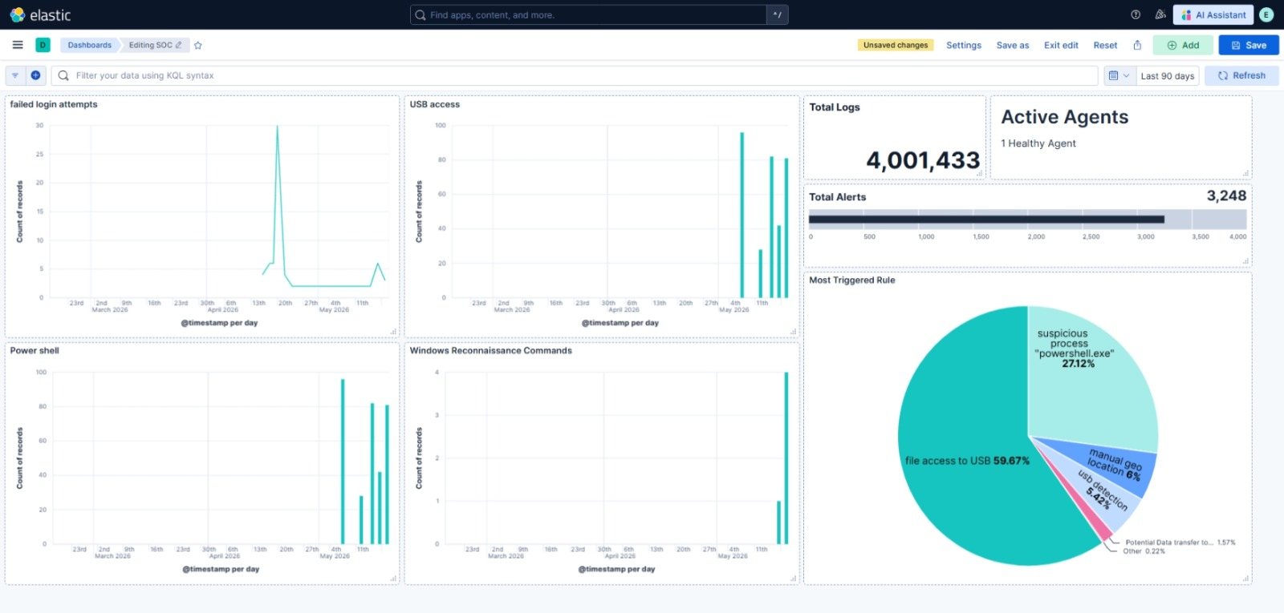
Risk Assessment & Performance KPIs
Kibana Security Dashboard
The Kibana dashboard provides:
Security Overview
Alert Monitoring
Event Visualization
Host Monitoring
Timeline Investigation
Speed

Slide 17
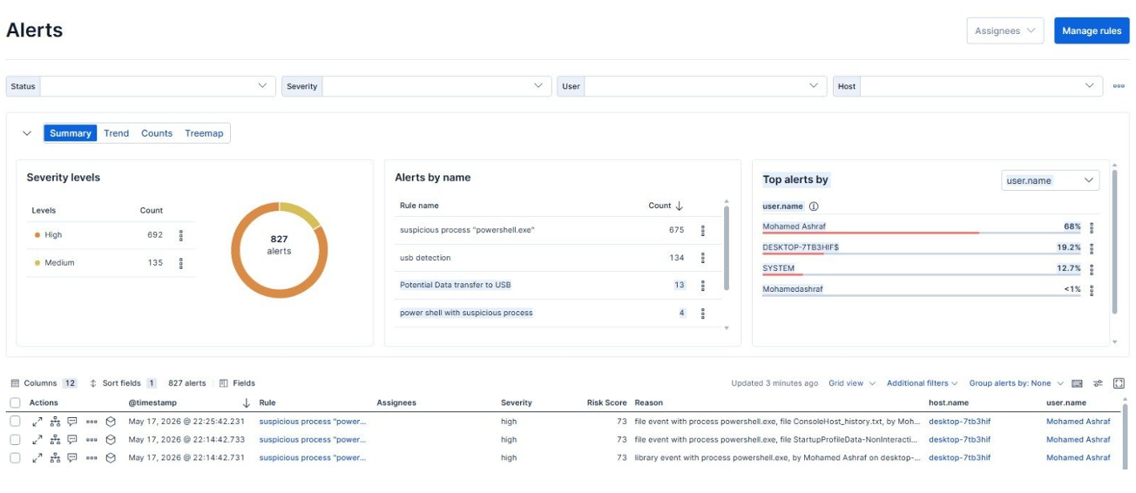
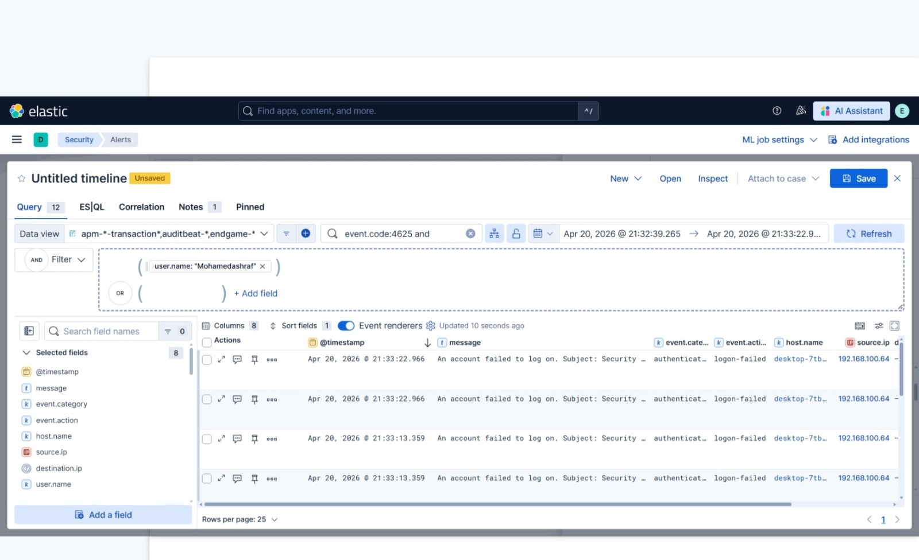
Incident investigation
Investigation steps:
Alert Received
Event Review
Timeline Analysis
Threat Validation
Root Cause Analysis
Incident Response
Documentation

Slide 18

conclusion
This project demonstrates the implementation of a Mini SOC architecture using the Elastic Stack for centralized monitoring and threat detection.
The system successfully collects logs, detects malicious activities, generates alerts, and supports incident investigation through Kibana dashboards and Elastic Security.
The project highlights the importance of SIEM solutions in improving cybersecurity visibility and incident response capabilities.

Slide 19

Q & A
Thank you for your attention!
Elastic Stack Based SOC Project | DEPI 2026
Supervisor: Osama AbdelAzim

